Slide 1
Higher Biology
Replication of DNA
Mr G R Davidson

Slide 2
DNA Replication
During cell division, the genes must be able to replicate in order that each new cell gets a full chromosome complement.
In order for replication to occur, the following must be present in the nucleus of the cell:
a supply of nucleotides (4 types)
ATP
a DNA molecule to copy
DNA polymerase (enzyme)
Ligase (enzyme)
primer

Slide 3
DNA Replication
Replication begins with the uncoiling of the DNA helix.
Once this has happened, the weak hydrogen bonds joining the two strands break, causing the DNA molecule to ‘unzip’.
Once the bases are exposed, a primer attaches to the end of each strand.

Slide 4
DNA Replication
The primer then causes the DNA polymerase to start adding free nucleotides to the 3’ end of the strand.
These nucleotides are joined together at the sugar-phosphate bond.
Hydrogen bonds form between the bases.
Ligase then joins the fragments to complete the strand.

Slide 5
DNA Replication
Because DNA can only have nucleotides added from the 3’ end, replication of the 2 strands is slightly different.
The 3’ end is continuous and forms the leading strand of the new DNA.

Slide 6
DNA Replication
The 5’ end must have the nucleotides added in fragments starting at the available bases of the exposed 3’ end.
Ligase is then used to join these fragments together.
This forms the lagging strand of the new DNA molecule and is described as discontinuous (because it is built in sections).

Slide 7
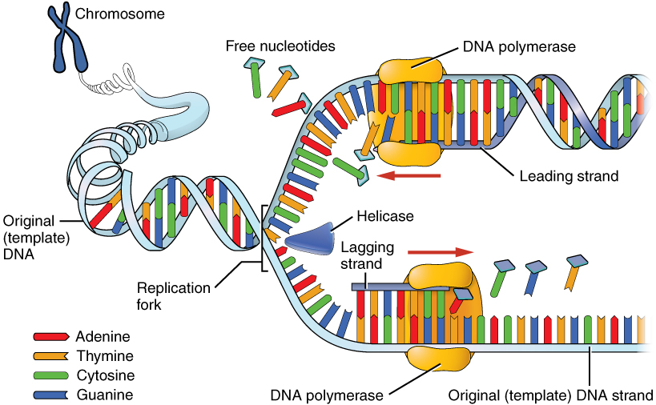
DNA Replication
3’ end of
parental strand
5’ end of
parental strand
©OpenStax College

Slide 8
DNA Replication
When particularly long chromosomes need to be copied, there are many replication forks operating at the same time.
This ensures that the DNA molecule is copied as quickly as possible.
This DNA carries the genetic code of the organism which makes up its genotype.

Slide 9
Polymerase Chain Reaction
The polymerase chain reaction (PCR) is a process used in laboratories to create multiple pieces of DNA outside the organism.
This is called DNA amplification.
A primer is used which is complementary to the specific target DNA.

Slide 10
Polymerase Chain Reaction
The DNA is heated to 95ºC which breaks the hydrogen bonds between the original DNA strands.
The sample is then cooled to around 55ºC to allow the addition of primers which bind to the start of each strand.
The sample is then heated to 72ºC and thermostable DNA polymerase is added. (Obtained from bacteria which live next to hot springs and can cope with high temperatures.)

Slide 11
Polymerase Chain Reaction
Complementary free nucleotides are added to the 3’ end of the new strands.
The number of the original strands is now doubled, then doubled again, and so on, showing exponential growth.

Slide 12
Polymerase Chain Reaction
This provides sufficient DNA to carry out a number of applications such as:
Genetic fingerprinting in forensics.
Archaeobiology.
Research.
Early infection detection.
Phylogenetics.
Notes:
Archaeobiology – the DNA found in mummies, skeletal remains and insects trapped in amber is usually highly degraded. Small samples can be amplified to generate more of the same DNA.
Research. PCR is used to create a large stock of particular DNA which can then be subjected to different types of analysis.
Early infection detection. PCR is used to amplify viral DNA to find out if there is infection or not.
Phylogenetics. Used to compare DNA samples from different areas of evolution to provide comparisons.

